Slide 1



Slide 2
Healthcare Philanthropy 2020
Nurses: Continuing the Care
As adapted from Advancement Resources
Notes:
Slide 2: Perspective (Photo of old/ young woman)
I wanted to start our conversation today with a brief discussion on perspective.
How many of you saw this on the agenda for the day and thought I was going to be telling you that in addition to all the things
Some of you may know this photo. When you first look at it, are you able to see a woman? How many of you, by a show of hands see a woman that appears older? And how many see a younger version of the woman? How many are able to see both?
You are probably wondering “Why is Jen from the Foundation showing is psychological photos this early in the morning?”
Today will be about perspective, and throughout our session today, some of the perspectives we know of philanthropy and giving may change.

Slide 3

Perspective
Healthcare Philanthropy
Nurses: Continuing the Care

Slide 4
Agenda
Healthcare Philanthropy
Nurses: Continuing the Care
Introduction
Overview of Healthcare Philanthropy
Process for Making Referrals
Notes:
Slide 4-6: Agenda
A run-down of our agenda for the session today:
A brief introduction about the Foundations supporting care at Spectrum Health and Helen DeVos Children’s Hospital
Overview of philanthropy in healthcare
And then we will talk about “How to make a referral”

Slide 5
Agenda
Healthcare Philanthropy
Nurses: Continuing the Care
Introduction
Overview of Healthcare Philanthropy
Process for Making Referrals

Slide 6
Agenda
Healthcare Philanthropy
Nurses: Continuing the Care
Introduction
Overview of Healthcare Philanthropy
Process for Making Referrals

Slide 7
Foundation: Who are we?
Healthcare Philanthropy
Nurses: Continuing the Care
Nursing scholarships and conference, program and service – maintenance and start-up, buildings, equipment, gas and meal cards for families, Renucci House, and much more….
400 million dollars raised since establishment in 1987!
Notes:
The role of Spectrum Health Foundation and Helen DeVos Children’s hospital Foundation’s are to provide resources for our clinical and family support programs and staff
These resources could be a clinical program, like the Blood and Marrow Transplant program, or a service such as Child Life. We help to fill in gaps of care that insurance does not cover, and also help to fund start-up projects like building HDVCH.
The foundations have collectively raised 400 million dollars since establishment in 1987!

Slide 8
Introduction
Healthcare Philanthropy
Nurses: Continuing the Care
What would you do?
Notes:
To kick off our discussion I wanted to bring a question to our group.
If wealthy individual breezed through the doors of your floor today and said I want to give you $1,000 to purchase anything you need for patient care, what would you purchase?
What about $100,000?
Keep these things in mind as we talk today.

Slide 9
Introduction
Healthcare Philanthropy
Nurses: Continuing the Care
  Why do you personally contribute time and/ or money to the causes that are important to you?
Notes:
We are going to get a more personal and I will need your help with this question.
You may be involved with an organization or a cause, would anyone be willing to share why they personally contribute your time/ and or money to that cause?
Thank you for sharing, it sounds to me like you personally invested in that cause because: “it speaks to your heart”, “you had a great experience”, “you want to affect change”.

Slide 10
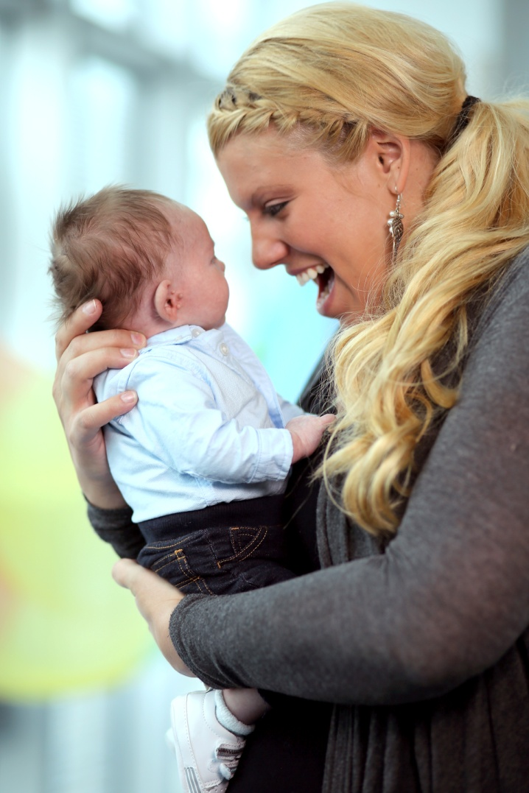
Grateful Patients and Families Concept
Healthcare Philanthropy
Nurses: Continuing the Care
  Contributions most meaningful to donors are based on a life experience
  Giving Video
  Life changing experiences may be positive or may be negative
Notes:
Research about donors tells us that individuals contribute to causes most meaningful to them, and that they are often based on a life experience.
This video is an excellent example of this.
This video is a great example of an individual that was touched by a life experience and was moved to give back.

Slide 11
The Patient Experience
Healthcare Philanthropy
Nurses: Continuing the Care
  Primary motivators for contributions most meaningful to donors are:
    A deeply held yearning to make a difference
    A human need to be engaged with respected people doing important work
    Personal stories influence how donors want to make a difference and the people with whom they want to be engaged
Notes:
Contributions that are most meaningful to donors will give them a deep sense of making a difference.
Research also shows that humans feel a need to engage with respected people doing important work.
Their personal stories will influence how they want to make a difference and with whom.

Slide 12
Grateful Patients and Families
Healthcare Philanthropy
Nurses: Continuing the Care
  Love, joy and gratitude are powerful emotions
  Frustration and anger are as well…Dollars are power
  It’s not about the money; Philanthropy may be a part of healing
Notes:
Here is where we might see a different view of our perspective woman.
These concepts relate to the work that you are doing every day. The patients that you help are find joy, gratitude and even love for the care you provide
To patients you provide more than a service, it’s a life changing experience. An experience that may motivate them to give back in ways very personal to them
And it might be a part of a healing process

Slide 13
Foundation: What is Our Role?
Healthcare Philanthropy
Nurses: Continuing the Care
We are grateful for the work you are doing, everyday.
Philanthropic professionals… you have a liaison!
“Why” example: $250,000 Microwave
Notes:
We are simply grateful for the work you do every day
As a part of this session, we’ve assigned philanthropic partners to you. When a patient expresses their desire to give back, it’s the role of your Foundation liaison to care for this individual listen to what they have in mind.
In the presentation a few weeks back, they shared a story which he referred to as the $250,000 microwave. A nurse shared a story where she was caring for a patient, whom expressed his desire to give back to their staff. She said to him that their floor could really use a new microwave, and his reply was “considered it done”. The next day, a brand new microwave was delivered to her floor. A week later, the nurse opened her newspaper and on the front page was the photo of this same individual with a story about how he’d made a $250,000 donation to another organization.
When you refer to a Foundation liaison, we’ll ensure that we do everything we can to understand their wishes and report back to you.

Slide 14
Listening for Cues and Clues
Healthcare Philanthropy
Nurses: Continuing the Care
Have you ever had a patient or family member say to you that they are so appreciative of their care, and they want to give you something?
Video of Dr. Simin Beg
Notes:
By a quick show of hands, have you had a patient or family member ever say to you that they are so appreciative of their care, and they want to give you something?
Something that may be routine to you, may have been life changing to a family.
Research tells us that by denying a family or a patient the ability to give back, may cause frustration and hurt.

Slide 15
Process for Philanthropic Referrals
Healthcare Philanthropy
Nurses: Continuing the Care
    Recognize
    Reinforce
    Redirect
    Review
    Refer
Notes:
Recognize: Hear the cue or clue the patient or family member is giving you. “I’d like to make a financial gift to the hospital, how do I do that?”
Reinforce: Affirm the individual’s intent – “I think that is wonderful.”
Redirect: explain that there is a team of philanthropy professionals who can assist him/ her. -- “The hospital has a team of people you can talk with to explore your options and decide the best approach for you.”
Review: Evaluate the individual’s level of receptiveness. Check verbal response, facial expression and body language of patient/ family member to evaluate level of receptiveness.”
Refer: Based on the individual’s level of receptiveness, connect him/ her appropriately with the office. “Would you like me to have the Foundation persons contact you?” or “Here is some information. You can call the Spectrum Health Foundation or Helen DeVos Children’s Hospital Foundation if you’d like to speak with someone about a gift.”

Slide 16
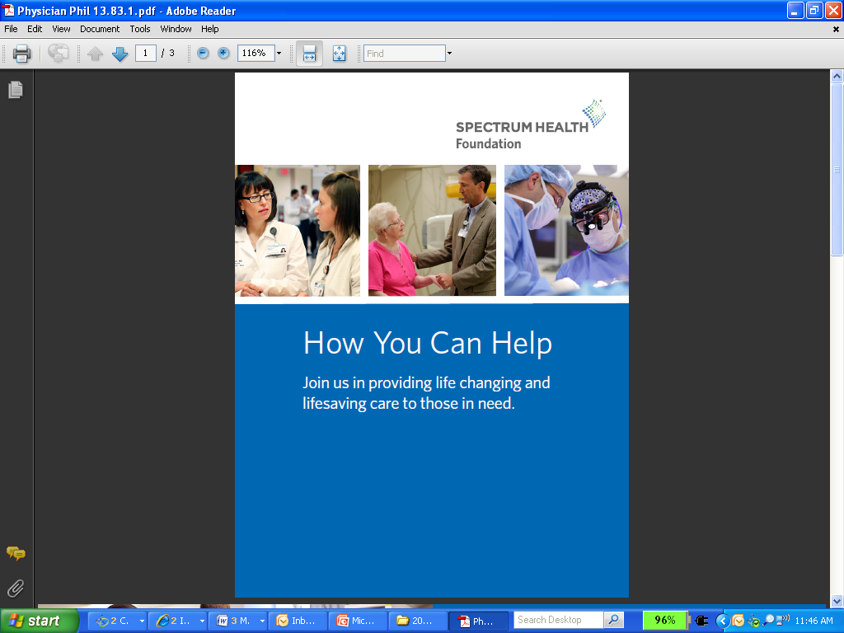
Process for Philanthropic Referrals
Healthcare Philanthropy
Nurses: Continuing the Care
  Referral Cards
    Cards can be kept somewhere with easy access, like the nurses’ station
  Foundation Liaisons
Notes:
We tried to make it simple, and created referral cards that you are able to give to families that indicate their desire to give back
The cards can be kept somewhere with easy access, like the nurses’ station
I was referred a patient from our cancer program by a physical therapist. The patient had expressed her desire to make a donation several times to her care giver. When we spoke, she said she could accept one more thing without giving a donation.
A family with an amazing story was referred to the Foundation by Dr. Quiroga at HDVCH. The family made a $1,000 donation back to his research because they were touched by their care.

Slide 17
Scenario 1
Healthcare Philanthropy
Nurses: Continuing the Care
Patient: I want to do something to thank you for the excellent care that you’ve given me.
Nurse: Oh, don’t worry about it. It’s my job to take care of people.
Better response: ___________________________
Notes:
Based on our discussion today, I wanted to run through a few different scenarios with our group. I will give you a moment to think of the answer and as for volunteers:
Patient: I want to do something to thank you for the excellent care that you’ve given me.
Nurse: Oh, don’t worry about it. It’s my job to take care of people.
Better response: Is that something I can help you with? What did you have in mind?

Slide 18
Scenario 2
Healthcare Philanthropy
Nurses: Continuing the Care
Family member: I really appreciate everything you and the other nurses did for my daughter. You truly went the extra miles and it meant the world to me and my family.
Nurse: Thank you, but we were just doing our jobs
Better response: ____________________________
Notes:
Family member: I really appreciate everything you and the other nurses did for my daughter. You truly went the extra miles and it meant the world to me and my family.
Nurse: Thank you, but we were just doing our jobs
Better response: Thank you, that means the world to me. (Accepting gratitude)

Slide 19
Scenario 3
Healthcare Philanthropy
Nurses: Continuing the Care
Patient: There must be something I can do to prevent other people from having to go through this.
Nurse: The best thing you can do right now is take care of yourself.
Better response: ___________________________
Notes:
Patient: There must be something I can do to prevent other people from having to go through this.
Nurse: The best thing you can do right now is take care of yourself.
Better response: What did you have in mind?

Slide 20
Thank you!
Activity: Referral Practice
Core concept: A philanthropic referral is a precious gift that extends care beyond the concerns of physical health and beyond any one patient.
What’s next? After you’ve made the philanthropic referral, the Foundation will report back to you on any progress of gifts that result from your referral.
Activity: Referral Practice
Core concept: A philanthropic referral is a precious gift that extends care beyond the concerns of physical health and beyond any one patient.
What’s next? After you’ve made the philanthropic referral, the Foundation will report back to you on any progress of gifts that result from your referral.
Healthcare Philanthropy
Nurses: Continuing the Care
To us, a philanthropic referral is a precious gift that extends care beyond the concerns of physical health and beyond any one patient.
What’s next? After you’ve made the philanthropic referral, your Foundation liaison will report back to you on any progress of gifts that result from your referral.
Notes:
To us, a philanthropic referral is a precious gift that extends care beyond the concerns of physical health and beyond any one patient.
What’s next? After you’ve made the philanthropic referral, your Foundation liaison will report back to you on any progress of gifts that result from your referral.

